Slide 1
WHATS IS JAVA-SCRIpt

Slide 2
What is JS ?
JavaScript is a popular programming language that has a many users.
JavaScript was previously used mainly for making webpages interactive as animation.
JavaScript is also used in many other areas such as server-side
development, mobile app development.
How to Open JS file ?
•Using console tab of web browsers
•Using Node.js
•By creating web pages

Slide 3
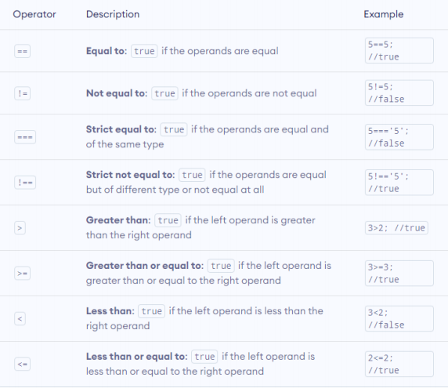
Comparison operators

Slide 4
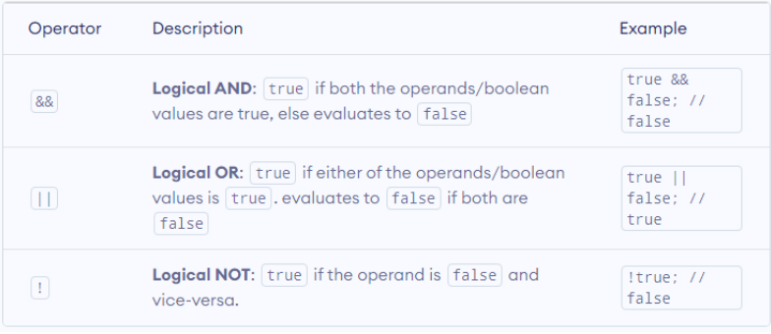
Comparison Logical operators

Slide 5
If / else
In computer programming, there may arise situations where you have to
run a block of code among more than one alternatives. For example,
assigning grades A, B or C based on marks obtained by a student.
In such situations, you can use the JavaScript if...else statement to create a
program that can make decisions.
In JavaScript, there are three forms of the
if...else statement.
1. if statement
2. if...else statement
3. if...else if...else statement

Slide 6
Switch
The switch statement evaluates an expression and executes the
corresponding body that matches the expression's result.
The switch statement evaluates a variable/expression
inside parenthesis().
• If the result of the expression is equal to value1, its
body is executed.
• If the result of the expression is equal to value2, its
body is executed.
• This process goes on. If there is no matching case, the
default body executes.

Slide 7
Ternary Operator
A ternary operator can be used to
replace an if..else statement in
certain situations.
What is Ternary Operator ?
A ternary operator evaluates a condition and executes a block of code
based on the condition.

Slide 8
For loop (break/continue) and While loop –
In programming, loops are used to repeat a block of code.
For example, if you want to show a message 100 times, then you can
use a loop. It's just a simple example; you can achieve much more with
loops.
This tutorial focuses on JavaScript for loops. You will learn about the
other type of loops in the upcoming tutorials.

